Slide 1

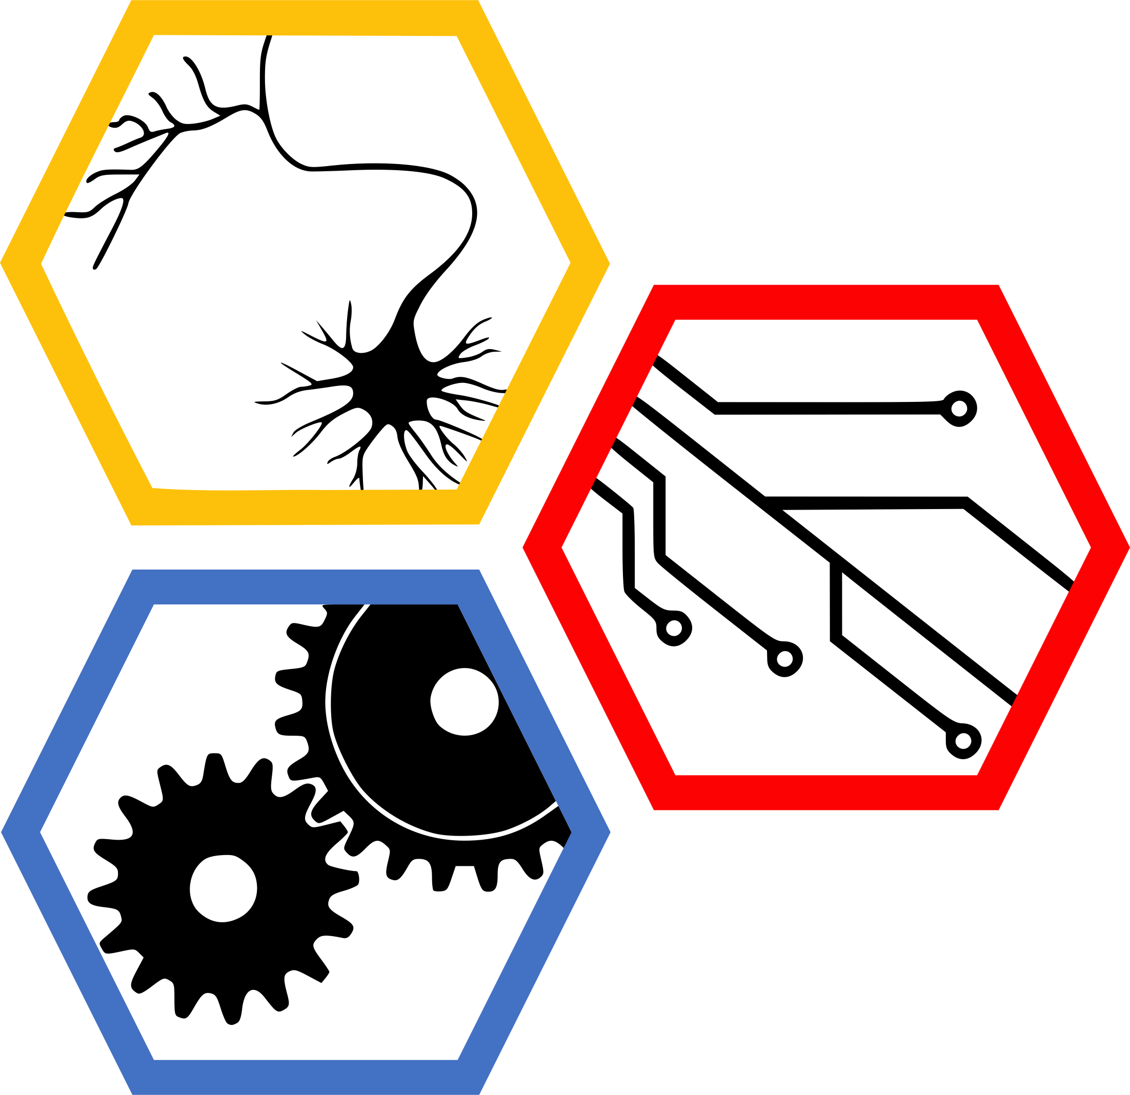
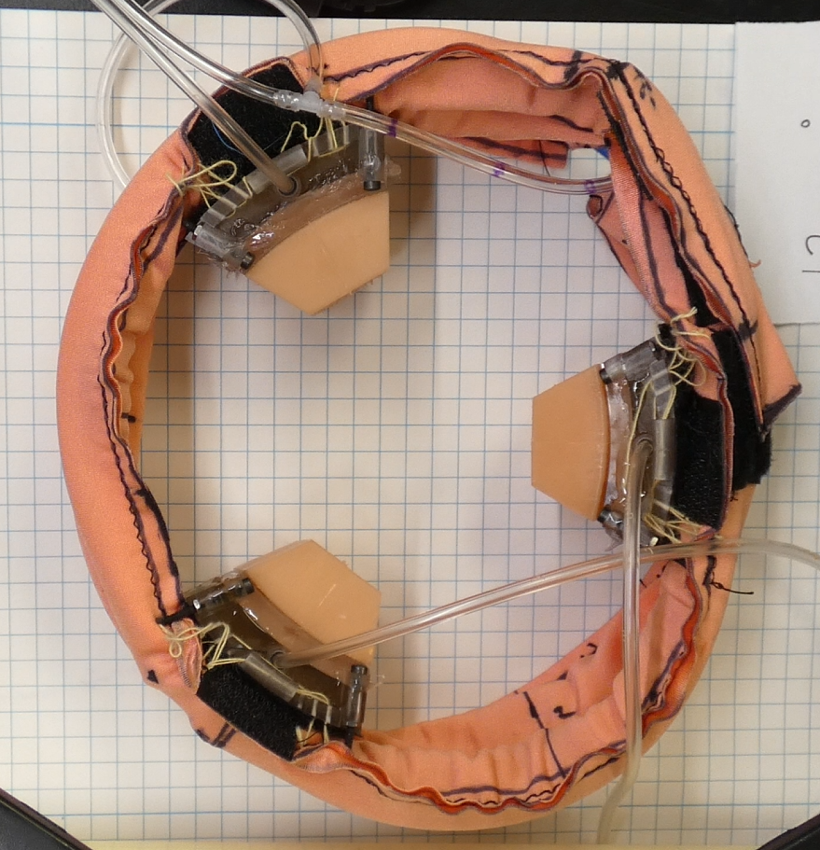
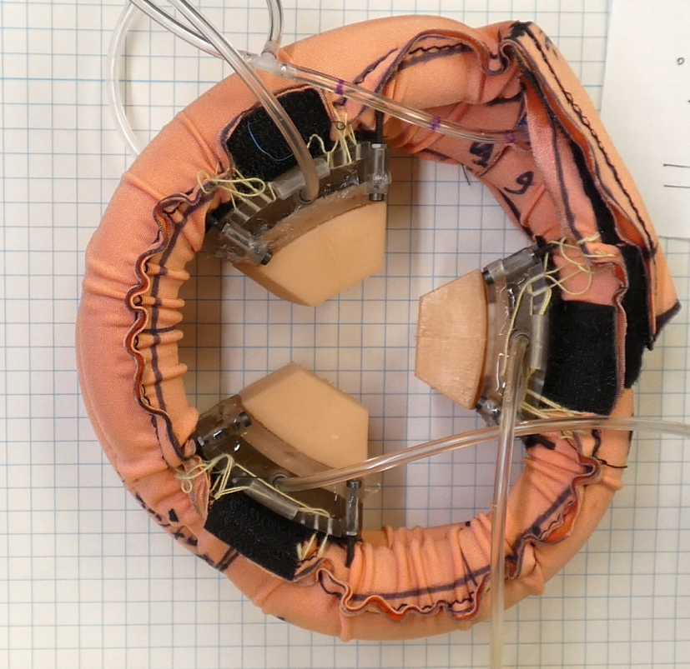
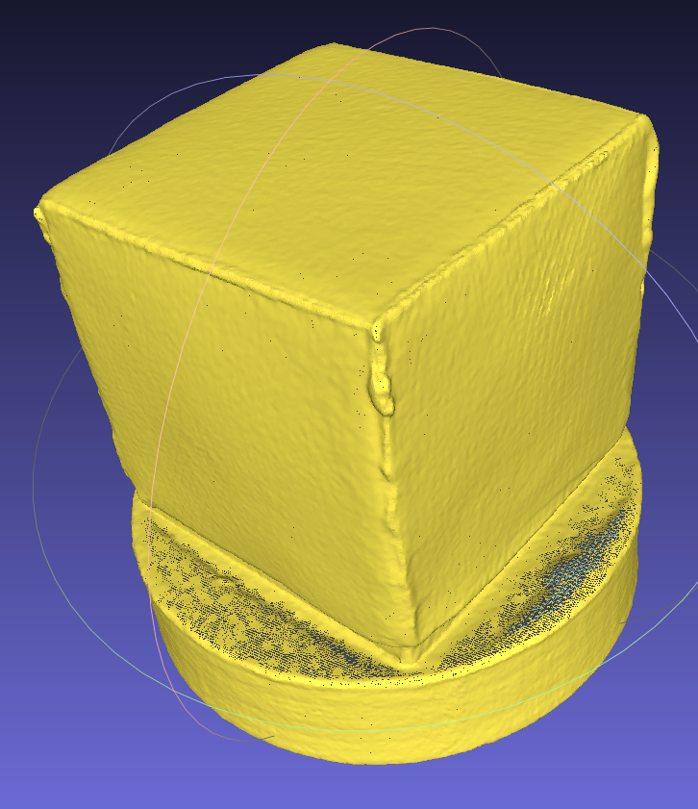
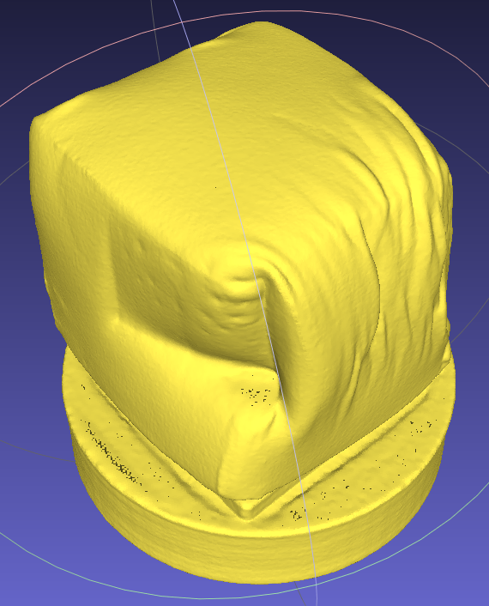
Data-Driven Control of a Soft Bioinspired Grasper
Ravesh Sukhnandan¹, Sreeram Thirupathi², Helen Wang¹, Nathan Zimmerer¹
Biohybrid and Organic Robotics Group
Carnegie Mellon University: 1) Mechanical Engineering, 2) Robotics Institute
Introduction
Methods
Results
Soft graspers have inherent advantages in handling fragile and deformable objects e.g. fruits, food, biological tissues
However, even very deformable items like soft clays may require active force control to minimize deformation
A
B
C
Fig. 4: (a) Eigenvalue plot (Re vs Imaginary of eigenvalues), (b) Quasistatic fit
Fig. 6: Simulation with PID for quasistatic and for Koopman. Add real hardware data with PID
No force control
Undeformed clay cube
After grasp
Fig. 1: Bio-inspired soft grasper with contact sensing via pneumatic jaws [1]. The grasper decreases the enclosed area when moving from the rest state (A) to the actuated state (B). Without force control, the grasper can impart significant deformations.
Conclusions
Results
Methods
Future Work
Fig. 3: Block/flow chart for Koopman to PID and for quasistatic to PID
Fig. 6:
Fig. 5: Koopman rollout vs real data. -> train and test.
Fig. 2: Experimental Setup to gather data for fitting

